Slide 1
SQL FINAL PROJECT

Slide 2
/* CREATE table ipl_ball And Upload */
CREATE TABLE ipl_ball(
id INT,
inning INT,
over INT,
ball INT,
batsman VARCHAR,
non_striker VARCHAR,
bowler VARCHAR,
batsman_runs INT,
extra_runs INT,
total_runs INT,
is_wicket INT,
dismissal_kind VARCHAR,
player_dismissed VARCHAR,
fielder VARCHAR,
extras_type VARCHAR,
batting_team VARCHAR,
bowling_team VARCHAR
);
COPY ipl_ball FROM 'D:\Data Science-SQL\SQL PROJECT\IPL Dataset\IPL_Ball csv.csv'DELIMITER','CSV HEADER;

Slide 3
*CREATE TABLE ipl_matches*
CREATE TABLE ipl_matches(
id INT,
city VARCHAR,
DATE date,
player_of_match VARCHAR,
venue VARCHAR,
neutral_venue INT,
team1 VARCHAR,
team2 VARCHAR,
toss_winner VARCHAR,
toss_decision VARCHAR,
winner VARCHAR,
result VARCHAR,
result_margin INT,
eliminator VARCHAR,
method VARCHAR,
umpire1 VARCHAR,
umpire2 VARCHAR
);
COPY ipl_matches FROM 'D:\Data Science-SQL\SQL PROJECT\IPL Dataset\IPL_matchescsv.csv'DELIMITER','CSV HEADER;

Slide 4
# Top 10 batsman strike_rate #
select batsman, count(ball) as total_balls, sum(batsman_runs) as total_runs,
(cast(sum(batsman_runs)AS float)/count(ball))*100 as strike_rate
from ipl_ball
where not extras_type IN ('wides')
group by batsman
having count(ball)>500
order by strike_rate DESC
limit 10;
batsman | total_balls | total_runs | strike_rate
AD Russell | 832 | 1517 | 182.3317308
SP Narine | 543 | 892 | 164.2725599
HH Pandya | 847 | 1349 | 159.2680047
V Sehwag | 1755 | 2728 | 155.4415954
GJ Maxwell | 973 | 1505 | 154.676259
RR Pant | 1368 | 2079 | 151.9736842
AB de Villiers | 3192 | 4849 | 151.9110276
CH Gayle | 3179 | 4772 | 150.1100975
KA Pollard | 2017 | 3023 | 149.8760535
JC Buttler | 1146 | 1714 | 149.5636998

Slide 5
(Top 10 Average_player)
SELECT batsman, total_runs, dismissed, seasons, CAST(total_runs AS FLOAT)/dismissed AS average_player
FROM (SELECT n.batsman, n.total_runs, n.dismissed, m.seasons
FROM (
SELECT batsman, COUNT(DISTINCT Year) as seasons
FROM (SELECT *
FROM (SELECT a.id,a.batsman, b.Year
FROM ipl_ball as a
INNER JOIN (SELECT id, EXTRACT(YEAR FROM date)as Year FROM ipl_matches ) as b
ON a.id=b.id) As Y) as n
GROUP BY batsman
HAVING COUNT(DISTINCT Year)>2
) as m
INNER JOIN (SELECT a.batsman, a.total_runs, b.dismissed
FROM (SELECT DISTINCT batsman,
SUM(batsman_runs) as total_runs
FROM ipl_ball
GROUP BY batsman) as a
INNER JOIN (
SELECT player_dismissed,SUM(is_wicket) as dismissed
FROM ipl_ball
GROUP BY player_dismissed
ORDER BY dismissed) as b
ON b.player_dismissed=a.batsman
WHERE dismissed>=1
ORDER BY dismissed DESC ) as n
ON m.batsman=n.batsman) as ipl
ORDER BY average_player DESC
LIMIT 10;

Slide 6
Result table (Average_player)
batsman | total_runs | dismissed | seasons | average_player
KL Rahul | 2647 | 59 | 7 | 44.86440678
Iqbal Abdulla | 88 | 2 | 8 | 44
DA Warner | 5254 | 123 | 11 | 42.71544715
CH Gayle | 4772 | 116 | 12 | 41.13793103
MS Dhoni | 4632 | 113 | 13 | 40.99115044
AB de Villiers | 4849 | 120 | 13 | 40.40833333
LMP Simmons | 1079 | 27 | 4 | 39.96296296
SE Marsh | 2477 | 62 | 9 | 39.9516129
JP Duminy | 2029 | 51 | 8 | 39.78431373
KS Williamson | 1619 | 41 | 6 | 39.48780488

Slide 7
(Top 10 hard hitting players)
SELECT m.batsman, m.seasons, m.total_runs, n.total_boundary, n.total_boundary_runs, (CAST(n.total_boundary_runs AS FLOAT)/m.total_runs)*100 as Boundary_percent
FROM (SELECT a.batsman, a.seasons, b.total_runs
FROM (SELECT batsman, COUNT(DISTINCT Year) as seasons
FROM (SELECT * FROM (SELECT a.id,a.batsman, b.Year
FROM ipl_ball as a
INNER JOIN (SELECT id, EXTRACT(YEAR FROM date)as Year FROM ipl_matches ) as b ON a.id=b.id) As Y) as n
GROUP BY batsman
HAVING COUNT(DISTINCT Year)>2 ) as a
INNER JOIN (SELECT DISTINCT batsman, SUM(batsman_runs) as total_runs FROM ipl_ball GROUP BY batsman ) as b
ON a.batsman=b.batsman) as m
INNER JOIN ( SELECT batsman, COUNT(batsman_runs) as total_boundary, SUM(batsman_runs) as total_boundary_runs
FROM (SELECT batsman, batsman_runs
FROM ipl_ball WHERE batsman_runs IN (4,6)) as fun
GROUP BY batsman ) as n
ON m.batsman=n.batsman
ORDER BY boundary_percent DESC
Limit 10;

Slide 8
Result table
batsman | seasons | total_runs | total_boundary | total_boundary_runs | boundary_percent
SP Narine | 9 | 892 | 155 | 724 | 81.16591928
AD Russell | 8 | 1517 | 234 | 1194 | 78.70797627
CH Gayle | 12 | 4772 | 733 | 3630 | 76.06873428
CR Brathwaite | 4 | 181 | 26 | 136 | 75.13812155
ST Jayasuriya | 3 | 768 | 123 | 570 | 74.21875
BCJ Cutting | 5 | 238 | 34 | 174 | 73.1092437
MJ McClenaghan | 5 | 85 | 12 | 62 | 72.94117647
AC Gilchrist | 6 | 2069 | 331 | 1508 | 72.88545191
MS Gony | 6 | 99 | 14 | 72 | 72.72727273
Mujeeb Ur Rahman | 3 | 11 | 2 | 8 | 72.72727273

Slide 10
(Top 10 economy bowler)
SELECT m.bowler, m.bowled,m.total_overs, n.given_runs, CAST(n.given_runs AS FLOAT)/m.total_overs AS Economy
FROM (SELECT a.bowler, a.bowled, b.total_overs
FROM (SELECT bowler, COUNT(ball ) as bowled
FROM ipl_ball
GROUP BY bowler
HAVING COUNT(ball)>=500 ) as a
INNER JOIN (SELECT bowler, COUNT(over) as total_overs
FROM (SELECT DISTINCT id, over, bowler
FROM ipl_ball
ORDER BY id, over ) as fun
GROUP BY bowler ) as b
ON a.bowler=b.bowler) as m
INNER JOIN (SELECT bowler, SUM(total_runs) as given_runs
FROM ipl_ball
GROUP BY bowler) as n
ON m.bowler=n.bowler
ORDER BY economy ASC
LIMIT 10;

Slide 11
Result table
bowler | bowled | total_overs | given_runs | economy
Rashid Khan | 1490 | 246 | 1573 | 6.39430894
A Kumble | 983 | 163 | 1089 | 6.6809816
DL Vettori | 785 | 131 | 894 | 6.82442748
M Muralitharan | 1577 | 255 | 1755 | 6.88235294
SP Narine | 2824 | 466 | 3208 | 6.88412017
Washington Sundar | 660 | 109 | 758 | 6.95412844
R Ashwin | 3327 | 540 | 3756 | 6.95555556
J Botha | 709 | 116 | 818 | 7.05172414
DW Steyn | 2276 | 364 | 2568 | 7.05494505
R Sharma | 935 | 155 | 1100 | 7.09677419

Slide 13
(TOP 10 best strike_rate bowler)
SELECT a.bowler, a.bowled, b.total_wickets, CAST(a.bowled AS FLOAT)/b.total_wickets AS Strike_rate
FROM (SELECT bowler, COUNT(ball ) as bowled
FROM ipl_ball
GROUP BY bowler
HAVING COUNT(ball)>=500) as a
INNER JOIN (SELECT bowler, COUNT(dismissal_kind) as total_wickets
FROM (SELECT bowler, dismissal_kind
FROM ipl_ball
WHERE NOT dismissal_kind IN ('NA','obstructing the field','run out','retired hurt')) as fun
GROUP BY bowler) as b
ON a.bowler=b.bowler
ORDER BY strike_rate ASC
LIMIT 10;

Slide 14
Result table
bowler | bowled | total_wickets | strike_rate
K Rabada | 840 | 61 | 13.7704918
AJ Tye | 645 | 40 | 16.125
DE Bollinger | 600 | 37 | 16.21621622
Imran Tahir | 1314 | 80 | 16.425
SL Malinga | 2974 | 170 | 17.49411765
S Aravind | 788 | 45 | 17.51111111
MA Starc | 612 | 34 | 18
YS Chahal | 2188 | 121 | 18.08264463
KK Cooper | 600 | 33 | 18.18181818
TA Boult | 1152 | 63 | 18.28571429

Slide 16
(Top 10 All-rounder players)
SELECT m.batsman as allrounder, m.total_balls as ball_faced, n.bowler,
n.bowled as ball_bowled, m.strike_rate as batting_strike_rate, n.bowler_strike_rate
FROM (SELECT batsman, COUNT(ball) as total_balls, SUM(batsman_runs) as total_runs,
(CAST(SUM(batsman_runs)AS FLOAT)/COUNT(ball))*100 AS strike_rate
FROM ipl_ball
WHERE NOT extras_type IN ('wides')
GROUP BY batsman
HAVING COUNT(ball)>=500) as m
INNER JOIN (SELECT a.bowler, a.bowled, b.bowler_total_wickets, CAST(a.bowled AS FLOAT)/b.bowler_total_wickets AS bowler_strike_rate
FROM (SELECT bowler, COUNT(ball ) as bowled
FROM ipl_ball
GROUP BY bowler
HAVING COUNT(ball)>=300) as a
INNER JOIN (SELECT bowler, COUNT(dismissal_kind) as bowler_total_wickets
FROM (SELECT bowler, dismissal_kind
FROM ipl_ball
WHERE NOT dismissal_kind IN ('NA','obstructing the field','run out','retired hurt')) as fun
GROUP BY bowler) as b
ON a.bowler=b.bowler) as n
On m.batsman=n.bowler
ORDER BY batting_strike_rate DESC, bowler_strike_rate ASC LIMIT 10;

Slide 17
allrounder | ball_faced | bowler | ball_bowled | batting_strike_rate | bowler_strike_rate
AD Russell | 832 | AD Russell | 1186 | 182.3317308 | 19.44262295
SP Narine | 543 | SP Narine | 2824 | 164.2725599 | 22.23622047
HH Pandya | 847 | HH Pandya | 914 | 159.2680047 | 21.76190476
GJ Maxwell | 973 | GJ Maxwell | 558 | 154.676259 | 29.36842105
CH Gayle | 3179 | CH Gayle | 584 | 150.1100975 | 32.44444444
KA Pollard | 2017 | KA Pollard | 1414 | 149.8760535 | 23.56666667
ST Jayasuriya | 532 | ST Jayasuriya | 301 | 144.3609023 | 23.15384615
YK Pathan | 2241 | YK Pathan | 1184 | 142.9718876 | 28.19047619
KH Pandya | 702 | KH Pandya | 1283 | 142.4501425 | 27.89130435
JA Morkel | 686 | JA Morkel | 1807 | 141.9825073 | 21.25882353

Slide 18
(Top 10 wicket_keeper)
SELECT m.fielder as wicket_keeper, m.stumping_wicket as stumping_out, m.caught_wicket as caught_out,
n.strike_rate as bat_strike_rate
FROM (SELECT a.fielder, a.stumping_wicket, b.caught_wicket
FROM (SELECT fielder, COUNT(dismissal_kind ) as stumping_wicket
FROM ipl_ball
WHERE dismissal_kind='stumped' AND NOT fielder='NA'
GROUP BY fielder) as a
LEFT JOIN (SELECT fielder, COUNT(dismissal_kind) as caught_wicket
FROM ipl_ball
WHERE dismissal_kind='caught'
GROUP BY fielder) as b
ON a.fielder=b.fielder) as m
LEFT JOIN (SELECT batsman, COUNT(ball) as total_balls, SUM(batsman_runs) as total_runs,
(CAST(SUM(batsman_runs)AS FLOAT)/COUNT(ball))*100 AS strike_rate
FROM ipl_ball
WHERE NOT extras_type IN ('wides')
GROUP BY batsman
HAVING COUNT(ball)>=500) as n
ON m.fielder=n.batsman
ORDER BY stumping_wicket DESC, caught_wicket DESC, bat_strike_rate DESC LIMIT 10;

Slide 19
wicket_keeper | stumping_out | caught_out | bat_strike_rate
MS Dhoni | 39 | 113 | 136.7581931
RV Uthappa | 32 | 87 | 129.9943567
KD Karthik | 30 | 118 | 129.6371651
WP Saha | 20 | 62 | 132.0213476
PA Patel | 16 | 69 | 120.7803223
AC Gilchrist | 16 | 51 | 138.3946488
Q de Kock | 12 | 49 | 133.5378323
RR Pant | 11 | 46 | 151.9736842
NV Ojha | 10 | 65 | 118.3549124
KC Sangakkara | 9 | 45 | 121.1925287

Slide 20
# Criteria for wicket_keeper #
# Caught,stumping & batting strike_rate are necessary skills required for best wicket-keeper.
# Stumping has been given most importace because this skill should be required for keeper because he needs to take stumping wickets.
# The wicket-keeper also needs good catching skill because the keeper needs to frequently catch the balls which are skip by batsman also balls which are touch by bat.
# Next preference is given to batting strike_rate because hard_hitting keeper can add runs to a team quickly in the fast played t20 matches rather than an average_player.
# Bowler has not given any preference for wicket-keeper because T20 ipl matches are fast type game.due to wicket_keeping & fewer overs the opportunity of bowling for wicket-keeper is very less as compare to other types of matches.

Slide 21
# Count of cities which have hosted ipl match #
SELECT COUNT( DISTINCT city) as total_cities_ipl_hosted FROM
MATCHES WHERE NOT CITY='NA';
# Create Table deliveries_v02#
CREATE TABLE deliveries_v02 AS
SELECT *,
CASE WHEN total_runs>=4 THEN 'Boundary'
WHEN total_runs=0 THEN 'Dot'
WHEN total_runs=1 THEN 'Single run'
WHEN total_runs=2 THEN 'Two runs'
WHEN total_runs=3 THEN 'Three runs'
END AS ball_result
FROM deliveries;
# total number of boundaries and dot balls #
SELECT ball_result,Count(ball_result) as count_of_score
from deliveries_v02
where ball_result IN ('Boundary','Dot')
GROUP BY ball_result;
count
32
ball_result | count_of_score
Boundary | 31468
Dot | 67841

Slide 22
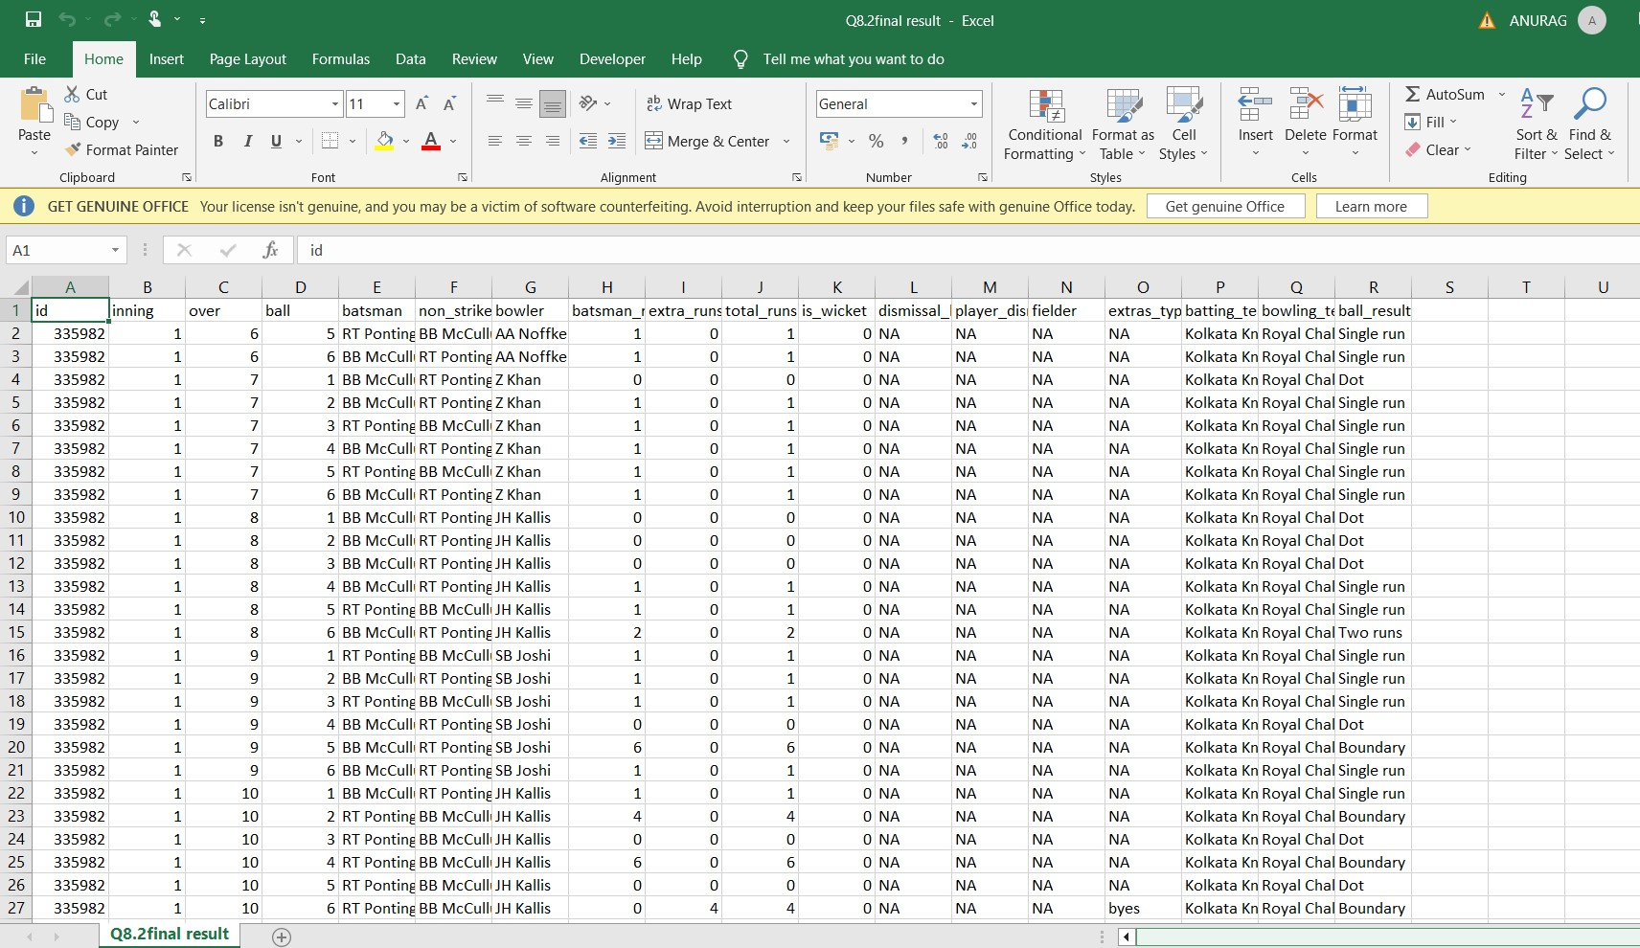
# Create Table deliveries_v02#

Slide 23
batting_team | boundaries
Mumbai Indians | 4118
Royal Challengers Bangalore | 3800
Kings XI Punjab | 3780
Kolkata Knight Riders | 3739
Chennai Super Kings | 3496
Rajasthan Royals | 3041
Delhi Daredevils | 3022
Sunrisers Hyderabad | 2306
Deccan Chargers | 1387
Pune Warriors | 733
Delhi Capitals | 659
Gujarat Lions | 624
Rising Pune Supergiant | 290
Rising Pune Supergiants | 242
Kochi Tuskers Kerala | 231
bowling_team | total_dot
Mumbai Indians | 8714
Royal Challengers Bangalore | 7955
Kolkata Knight Riders | 7894
Kings XI Punjab | 7679
Chennai Super Kings | 7593
Rajasthan Royals | 6665
Delhi Daredevils | 6520
Sunrisers Hyderabad | 5248
Deccan Chargers | 3306
Pune Warriors | 1900
Delhi Capitals | 1338
Gujarat Lions | 1095
Rising Pune Supergiant | 698
Kochi Tuskers Kerala | 626
Rising Pune Supergiants | 539
NA | 71
# Total numbers of boundary scored #
SELECT batting_team, COUNT(ball_result) as Boundaries
FROM deliveries_v02
WHERE ball_result='Boundary'
GROUP BY batting_team
ORDER BY COUNT(ball_result) DESC
;
# Total number of dot balls bowled by each team #
SELECT bowling_team, COUNT(ball_result) as total_dot
FROM deliveries_v02
WHERE ball_result='Dot'
GROUP BY bowling_team
ORDER BY total_dot DESC;
# Total number of dismissals by dismissals kind #
SELECT DISTINCT dismissal_kind, COUNT(dismissal_kind) as dismissal_kind_total
FROM deliveries_v02
WHERE NOT dismissal_kind='NA'
GROUP BY dismissal_kind;
dismissal_kind | dismissal_kind_total
bowled | 1700
caught | 5743
caught and bowled | 269
hit wicket | 12
lbw | 571
obstructing the field | 2
retired hurt | 11
run out | 893
stumped | 294

Slide 25
# Top 5 bowlers who conceded maximum extra runs #
SELECT bowler, SUM(extra_runs) as total_extras_given
FROM deliveries
GROUP BY bowler
ORDER BY SUM(extra_runs) DESC
LIMIT 5;
# Create table deliveries_v03 from deliveries_v02 and additional column venue and date from matches #
CREATE TABLE deliveries_v03 AS
SELECT a.*, b.venue, b.date
FROM deliveries_v02 as a
LEFT JOIN matches as b
On a.id=b.id;
select * from deliveries_v03;
# Total runs scored for each venue #
SELECT * FROM deliveries_v03 ;
SELECT venue, SUM(total_runs) as total_venue_runs
FROM deliveries_v03
GROUP BY venue
ORDER BY SUM(total_runs) DESC;
bowler | total_extras_given
SL Malinga | 293
P Kumar | 236
UT Yadav | 226
DJ Bravo | 210
B Kumar | 201

Slide 26
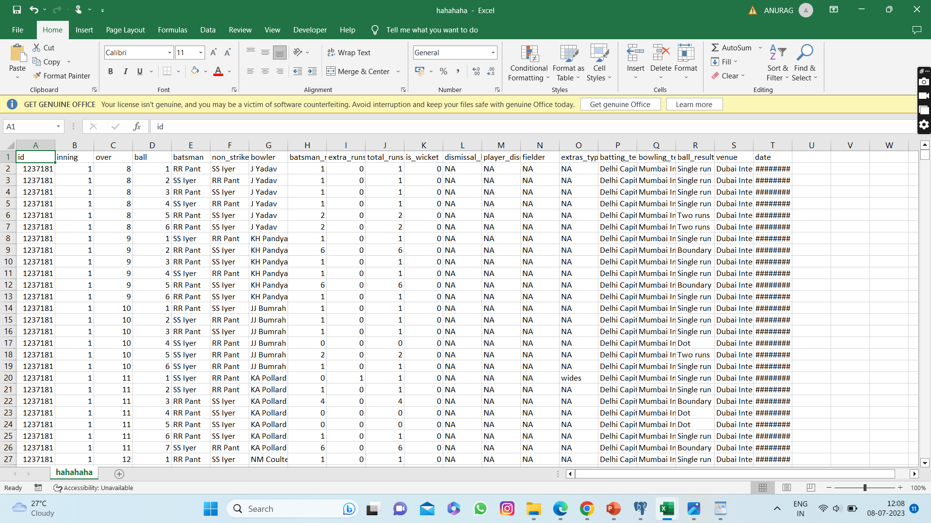
# Create table deliveries_v03 from deliveries_v02 and additional column venue and date from matches #

Slide 27
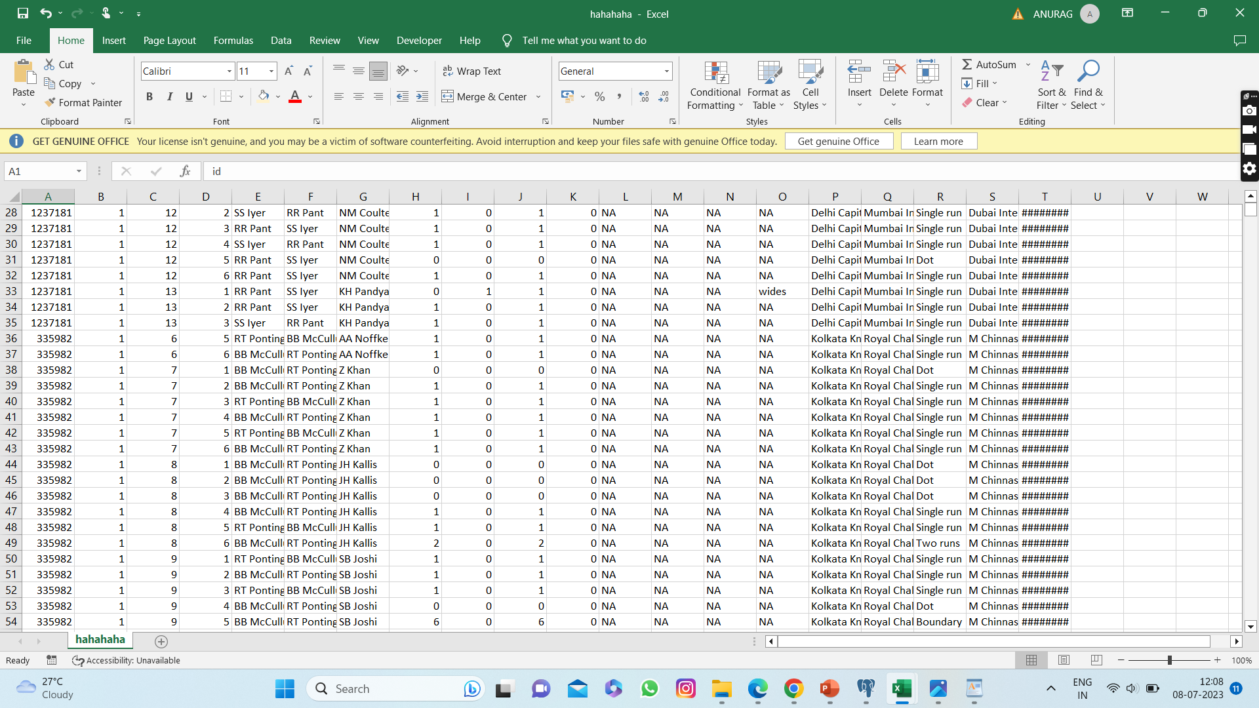
# Create table deliveries_v03 from deliveries_v02 and additional column venue and date from matches #

Slide 28
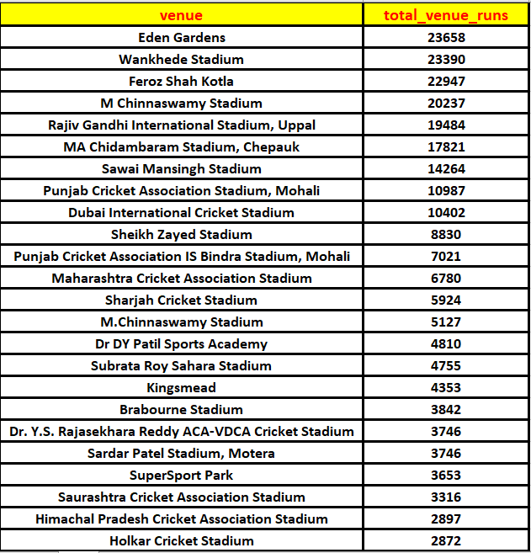
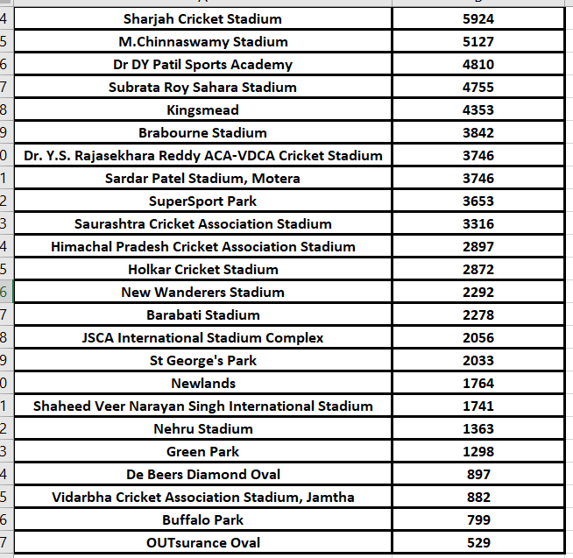
# Total runs scored for each venue #

Slide 29
# Year-wise total runs scored at ‘Eaden Gardens’ #
SELECT venue, EXTRACT(Year FROM date) as Year, SUM(total_runs) as total_runs_year
FROM deliveries_v03
WHERE venue='Eden Gardens'
GROUP BY venue,EXTRACT(Year FROM date)
ORDER BY SUM(total_runs) DESC;
venue | year | total_runs_year
Eden Gardens | 2018 | 2885
Eden Gardens | 2019 | 2651
Eden Gardens | 2015 | 2386
Eden Gardens | 2013 | 2304
Eden Gardens | 2017 | 2194
Eden Gardens | 2010 | 2167
Eden Gardens | 2016 | 2073
Eden Gardens | 2012 | 2012
Eden Gardens | 2011 | 1854
Eden Gardens | 2008 | 1843
Eden Gardens | 2014 | 1289

